Slide 1
Neural Networks II
Neural Networks II
Convolutional Neural Networks
Dr. Bharathi R
CSE Department

Slide 2
SE ZG568/SS ZG568 , Applied Machine Learning
Lecture No.9.1- Module 9

Slide 3
In This Session
Introduction to Convolutional Networks
Fully Connected Layer
Convolution Layer
Edge Detector

Slide 4
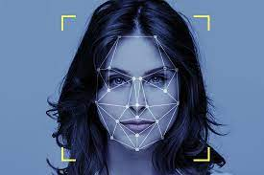
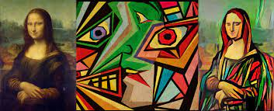
Convolutional Neural Networks (CNN)
2.Style Transfer
1.Face recognition
two images named as original content images and the style reference images are blended together by the algorithms. This blending is done in such a way that the resulting image looks like the original content image but painted in the style of the style reference image.
A facial recognition system is a technology capable of matching a human face from a digital image or a video frame against a database of faces.

Slide 5
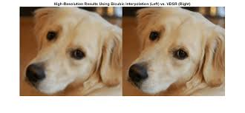
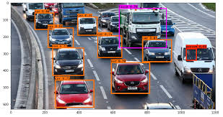
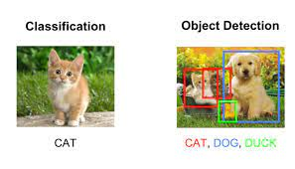
Convolutional Neural Networks (CNN)
3.Image Quality Enhancement
4. Object Detection
5. Classification

Slide 6
Convolutional Neural Networks (CNN)
Computer Vision is a sub-field of artificial intelligence and deep learning that enable machines to view the world as humans do, to understand and interpret the visual world
Used for a multitude of tasks such as image recognition, Object identification, Facial recognition, Image Segmentation, Image Classification, Recommendation Systems, Natural Language Processing, medical imaging etc.
Computer vision works with digital images and videos
An image consists of several pixels, with a pixel being the smallest quanta in which the image can be divided into.
Images are processed in the form of an array of pixels, where each pixel has a set of values, representing the presence and intensity of the three primary colors: red, green, and blue.
All pixels come together to form a digital image.

Slide 7
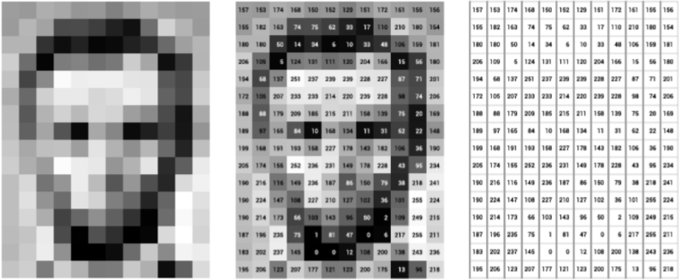
Convolutional Neural Networks (CNN)
How does a computer see an image?
Source: https://www.v7labs.com/blog/what-is-computer-vision

Slide 8
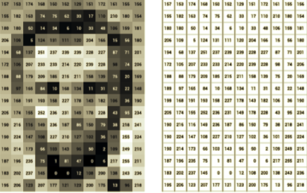
How does a computer see an image? As a Matrix
The digital image, thus, becomes a matrix, and Computer Vision becomes a study of matrices.
While the simplest computer vision algorithms use linear algebra to manipulate these matrices.
Complex applications involve operations like convolutions with learnable kernels and downsampling via pooling.
The values represent the pixel values at the particular coordinates in the image, with 255 representing a complete white point and 0 representing a complete dark point.
For larger images, matrices are much larger.

Slide 9
Convolutional Neural Networks (CNN)
Some operations commonly used in computer vision based on a Deep Learning perspective include:
Convolution: Convolution in computer vision is an operation in which a learnable kernel is “convolved” with the image. In other words—the kernel is slided across the image pixel by pixel, and an element-wise multiplication is performed between the kernel and the image at every pixel group.
Pooling: Pooling is an operation used to reduce the dimensions of an image by performing operations at a pixel level. A pooling kernel slides across the image, and only one pixel from the corresponding pixel group is selected for further processing, thus reducing the image size., eg., Max Pooling, Average Pooling.
Non-Linear Activations: Non-Linear activations introduce non-linearity to the neural network, thereby allowing the stacking of multiple convolutions and pooling blocks to increase model depth.

Slide 10
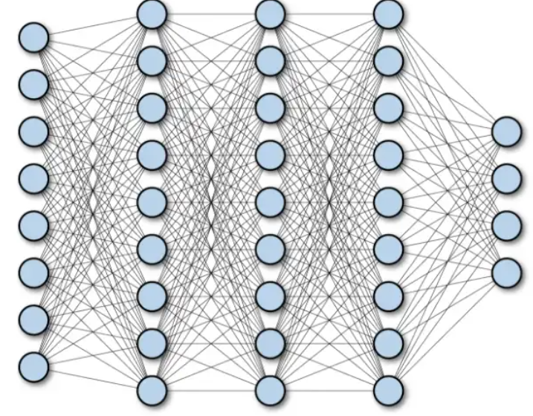
CNN Vs Fully Connected Network
A fully connected neural network consists of a series of fully connected layers that connect every neuron in one layer to every neuron in the other layer.
For eg a 28x28 image in fully connected neural nets, each pixel in the input image is assigned to a neuron for a total of 784 (28 x 28 pixels) input neurons.
This strategy does not leverage the spatial structure and relations of each image.
They have a higher number of weights to train that results in high training time
Multilayer Deep Fully Connected Network

Slide 11
Convolutional Neural Networks (CNN)
Special kind of neural network for processing data that has a known, grid-like topology.
e.g., Time-series data – 1D grid taking samples at regular time intervals.
e.g., Image data – 2D grid of pixels.
Network employs a mathematical operation called convolution.
Convolutional networks are simply neural networks that use convolution in place of general matrix multiplication in some of their layers.

Slide 12
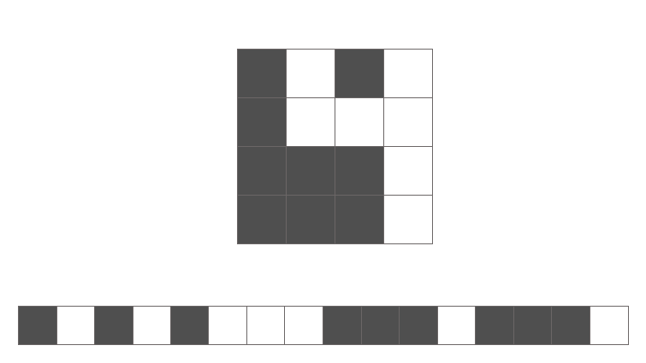
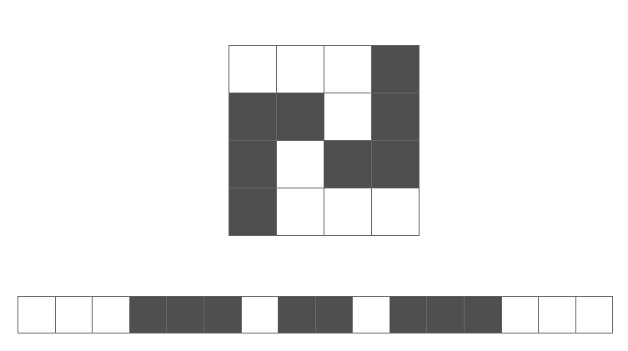
Convolutional Neural Networks (CNN)
Unfortunately, we lose a great deal of information about the picture when we convert the 2D array of pixel values into a vector; specifically, we lose the spatial relationships within the data.
Could you identify the following numbers in flattened vector form without rearranging the pixels back into a 2D array in your head?

Slide 13
Convolutional Neural Networks (CNN)
The spatial arrangement of features (pixels) is important because we see in a relativistic perspective. This is where convolutional neural networks shine.
A convolution layer defines a window by which we examine a subset of the image, and subsequently scans the entire image looking through this window.
As you'll see below, we can parameterize the window to look for specific features (e.g. edges) within an image. This window is also sometimes called a filter, since it produces an output image which focuses solely on the regions of the image which exhibited the feature it was searching for.
The output of a convolution is referred to as a feature map.
Note: Windows, filters, and kernels all refer to the same thing with respect to convolutional neural networks; don't get confused if you see one term being used instead of another.

Slide 14
Convolutional Neural Networks (CNN)

Slide 15
Convolutional Neural Networks (CNN)

Slide 16
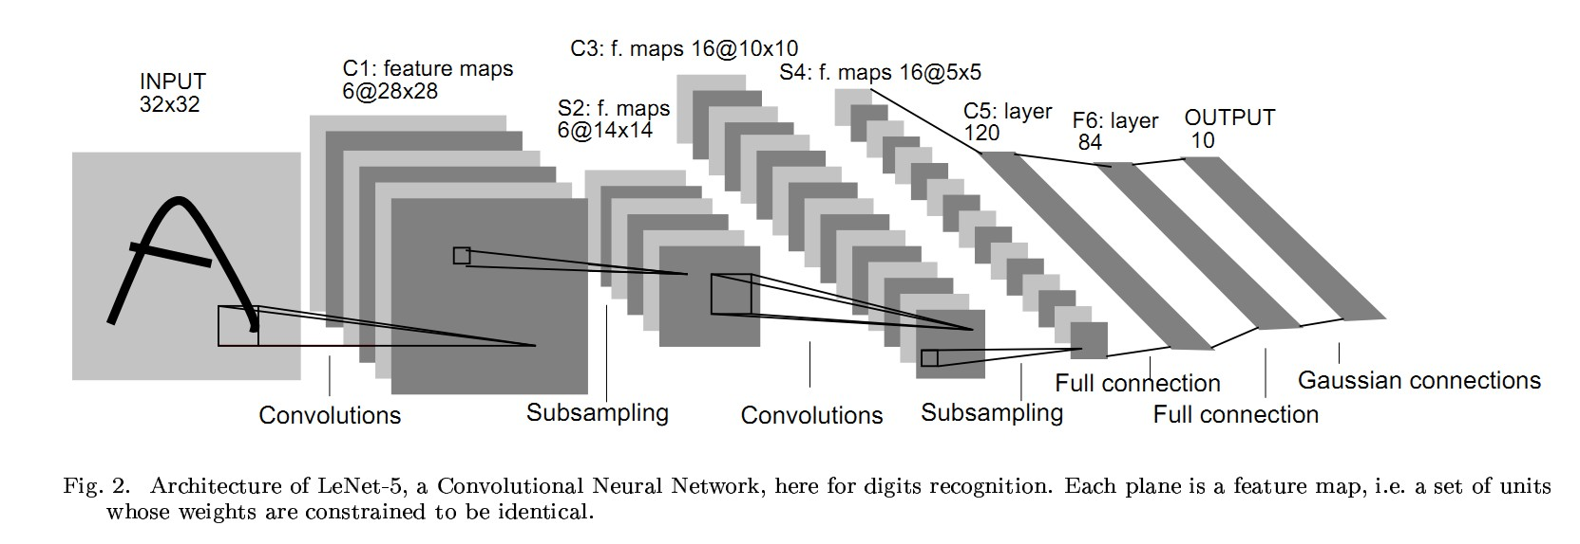

LeNet-5
Handwritten Character recognition 10-categories classification problem

Slide 17
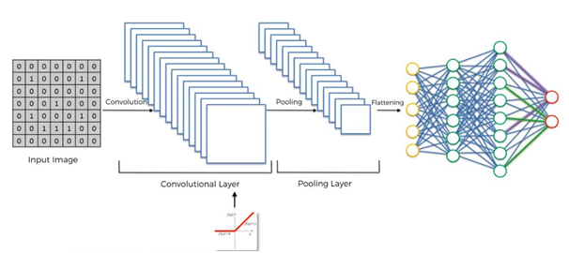
Construction of CNN

Slide 18

Types of Layers
Convolution (Conv) Layer
Pooling (Pool) Layer
Fully Connected (FC) Layer

Slide 19
1.Convolution (Conv) Layer
Perform Convolution operation
Image
Kernel 5 × 5 × 3
Conv 1
Image
Input
n_{H} × n_{W} × n_{C}
Conv 1
(1) (1)
n × n × n
C
H W

Slide 20
Convolution Operation
Suppose we want to detect edges from an image.
The image will have vertical edges and horizontal edges.
Convolve the image with a kernel or filter to extract both the vertical edges and horizontal edges.
Input Size : n × n
Kernel Size : f × f
Ouput Size : (n − f + 1) × (n − f + 1)

Slide 21
Convolution Operation
Input Image 6 × 6
3 | 0 | 1 | 2 | 7 | 4
1 | 5 | 8 | 9 | 3 | 1
2 | 7 | 2 | 5 | 1 | 3
0 | 1 | 3 | 1 | 7 | 8
4 | 2 | 1 | 6 | 2 | 8
2 | 4 | 5 | 2 | 3 | 9
_{Kernel 3 × 3} Output Image 4 × 4
1 | 0 | -1
1 | 0 | -1
1 | 0 | -1
*
=

Slide 22
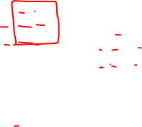
Convolution Operation
Input Image 6 × 6
3 | 0 | 1 | 2 | 7 | 4
1 | 5 | 8 | 9 | 3 | 1
2 | 7 | 2 | 5 | 1 | 3
0 | 1 | 3 | 1 | 7 | 8
4 | 2 | 1 | 6 | 2 | 8
2 | 4 | 5 | 2 | 3 | 9
_{Kernel 3 × 3} Output Image 4 × 4
1 | 0 | -1
1 | 0 | -1
1 | 0 | -1
*
=
value = 3(1) + 1(1) + 2(1) + 0(0) + 0(5) + 7(0) + 1(−1) + 8(−1) + 2(−1)
= −5

Slide 23
Convolution Operation
Input Image 6 × 6
3 | 0 | 1 | 2 | 7 | 4
1 | 5 | 8 | 9 | 3 | 1
2 | 7 | 2 | 5 | 1 | 3
0 | 1 | 3 | 1 | 7 | 8
4 | 2 | 1 | 6 | 2 | 8
2 | 4 | 5 | 2 | 3 | 9
_{Kernel 3 × 3} Output Image 4 × 4
-5
1 | 0 | -1
1 | 0 | -1
1 | 0 | -1
*
=
value = 0(1) + 5(1) + 7(1) + 1(0) + 8(0) + 5(0) + 2(−1) + 9(−1) + 5(−1)
= −4

Slide 24
Convolution Operation
Input Image 6 × 6
3 | 0 | 1 | 2 | 7 | 4
1 | 5 | 8 | 9 | 3 | 1
2 | 7 | 2 | 5 | 1 | 3
0 | 1 | 3 | 1 | 7 | 8
4 | 2 | 1 | 6 | 2 | 8
2 | 4 | 5 | 2 | 3 | 9
_{Kernel 3 × 3} Output Image 4 × 4
-5 | -4 | 0 | 8
-10 | -2 | -2 | 3
0 | -2 | -4 | -7
-3 | -2 | -3 | -16
1 | 0 | -1
1 | 0 | -1
1 | 0 | -1
*
=
value = 1(1) + 6(1) + 2(1) + 7(0) + 2(5) + 3(0) + 8(−1) + 8(−1) + 9(−1)
= −16

Slide 25





Fully Connected (FC) Layer
Stack of neurons in one layer is connected to every other neuron in another layer.
FC1 FC2 LR
yˆ₁

Slide 26

Vertical Edge Detector
Input Image 6 × 6
10 | 10 | 10 | 0 | 0 | 0
10 | 10 | 10 | 0 | 0 | 0
10 | 10 | 10 | 0 | 0 | 0
10 | 10 | 10 | 0 | 0 | 0
10 | 10 | 10 | 0 | 0 | 0
10 | 10 | 10 | 0 | 0 | 0
_{Kernel 3 × 3} Output 4 × 4
0 | 30 | 30 | 0
0 | 30 | 30 | 0
0 | 30 | 30 | 0
0 | 30 | 30 | 0
1 | 0 | -1
1 | 0 | -1
1 | 0 | -1
*
=

Slide 27
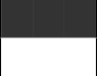
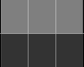
Horizontal Edge Detector
Input Image 6 × 6
10 | 10 | 10 | 10 | 10 | 10
10 | 10 | 10 | 10 | 10 | 10
10 | 10 | 10 | 10 | 10 | 10
0 | 0 | 0 | 0 | 0 | 0
0 | 0 | 0 | 0 | 0 | 0
0 | 0 | 0 | 0 | 0 | 0
_{Kernel 3 × 3} Output 4 × 4
0 | 0 | 0 | 0
30 | 30 | 30 | 30
30 | 30 | 30 | 30
0 | 0 | 0 | 0
1 | 1 | 1
0 | 0 | 0
-1 | -1 | -1
*
=

Slide 28
Edge Detectors
Similarly edge at 45◦, 60◦ and all can be detected, by appropriately choosing the kernels or filters.
Then stack the different filters to obtain edges.
The aim of the Convolution layer will be learn the filter or kernel matrix.
The NN will learn the 9 weights in the filter.
Filter 3 × 3
w₁ | w₂ | w₃
w₄ | w₅ | w₆
w₇ | w₈ | w₉

Slide 29

Padding, Striding, Pooling

Slide 30
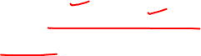
CNN:Padding, Striding, Pooling
Dr. Bharathi R
CSE Department

Slide 31
SE ZG568/SS ZG568 , Applied Machine Learning
Lecture No.9.2- Module 9

Slide 32
In This Session
Padding
Striding
Pooling
Max Pooling
Average Pooling

Slide 33
Stride and Padding
UE20CS343 -TDL-CNN
The convolution operation is also described by two concepts:
1. Striding
2.Padding

Slide 34
Convolution Operation
Input Image 6 × 6
3 | 0 | 1 | 2 | 7 | 4
1 | 5 | 8 | 9 | 3 | 1
2 | 7 | 2 | 5 | 1 | 3
0 | 1 | 3 | 1 | 7 | 8
4 | 2 | 1 | 6 | 2 | 8
2 | 4 | 5 | 2 | 3 | 9
_{Kernel 3 × 3} Output Image 4 × 4
-5 | -4 | 0 | 8
-10 | -2 | -2 | 3
0 | -2 | -4 | -7
-3 | -2 | -3 | -16
1 | 0 | -1
1 | 0 | -1
1 | 0 | -1
*
=

Slide 35
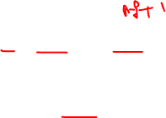
Padding
When filter is convolved with the input image
⁾ Image shrinks – 6 × 6 image became a 4 × 4 image.
⁾ Pixels in the corners are used only once, when compared the pixels in the middle. The data in the corners are thrown away.
To resolve, apply padding to the input image before convolution. Padding means append zeros around the boundary of the input.

Slide 36
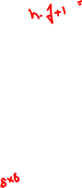
Convolution with Padding
Input Image with padding 8 × 8
0 | 0 | 0 | 0 | 0 | 0 | 0 | 0
0 | 3 | 0 | 1 | 2 | 7 | 4 | 0
0 | 1 | 5 | 8 | 9 | 3 | 1 | 0
0 | 2 | 7 | 2 | 5 | 1 | 3 | 0
0 | 0 | 1 | 3 | 1 | 7 | 8 | 0
0 | 4 | 2 | 1 | 6 | 2 | 8 | 0
0 | 2 | 4 | 5 | 2 | 3 | 9 | 0
0 | 0 | 0 | 0 | 0 | 0 | 0 | 0
Kernel 3 × 3
*
1 | 0 | -1
1 | 0 | -1
1 | 0 | -1

Slide 37

Padding
Two kinds of padding
⁾ Valid Padding
^{Ç} Padding is not applied.
p = 0
^{Ç} Output shrinks when compared to the input.
⁾ Same Padding
^{Ç} Padding is applied.
_{p =} f − 1
2
^{Ç} Input size = output size.
^{Ç} We maintain the size of input and output as the same.

Slide 38
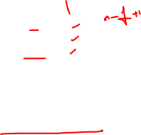
Padding
How much to pad?
Padding : p = ^{f -1}
2
Kernel 3 × 3 : p = 1
Kernel 5 × 5 : p = 2
Kernel 7 × 7 : p = 3
Padding preserves the input size.
Input Size : n × n
Padding : p
Kernel Size : f × f
Ouput Size : (n + 2p − f + 1) × (n + 2p − f + 1)

Slide 39
Strided Convolution
Strided convolution is another piece that are used in CNNs.
We will call stride S.
When we are making the convolution operation we used S to tell us the number of pixels we will jump when we are convolving filter/kernel. The last examples we described S was 1.

Slide 40
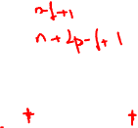
Striding
Skip by how many pixels.
Input Size : n × n
Padding : p
Stride : s
Kernel Size : f × f
, , , ,
n + 2p − f ₊ ₁ n + 2p − f ₊ ₁
Ouput Size :
×
s
s
The filter must lie completely inside the input.

Slide 41
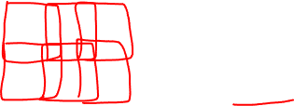
Convolution with Stride
Input Image 7 × 7
2 | 4 | 7 | 4 | 6 | 2 | 9
6 | 6 | 9 | 8 | 7 | 4 | 3
3 | 4 | 8 | 3 | 8 | 9 | 7
7 | 8 | 3 | 6 | 6 | 3 | 4
4 | 2 | 1 | 8 | 2 | 4 | 6
3 | 2 | 4 | 1 | 9 | 8 | 3
0 | 1 | 3 | 9 | 2 | 1 | 4
Kernel 3 × 3
Stride = 2
Output 3 × 3
91
*
3 | 4 | 4
1 | 0 | 2
-1 | 0 | 3
=

Slide 42
Convolution with Stride
Input Image 7 × 7
2 | 4 | 7 | 4 | 6 | 2 | 9
6 | 6 | 9 | 8 | 7 | 4 | 3
3 | 4 | 8 | 3 | 8 | 9 | 7
7 | 8 | 3 | 6 | 6 | 3 | 4
4 | 2 | 1 | 8 | 2 | 4 | 6
3 | 2 | 4 | 1 | 9 | 8 | 3
0 | 1 | 3 | 9 | 2 | 1 | 4
Kernel 3 × 3
Stride = 2
Output 3 × 3
91 | 100
*
3 | 4 | 4
1 | 0 | 2
-1 | 0 | 3
=

Slide 43
Convolution with Stride
Input Image 7 × 7
2 | 4 | 7 | 4 | 6 | 2 | 9
6 | 6 | 9 | 8 | 7 | 4 | 3
3 | 4 | 8 | 3 | 8 | 9 | 7
7 | 8 | 3 | 6 | 6 | 3 | 4
4 | 2 | 1 | 8 | 2 | 4 | 6
3 | 2 | 4 | 1 | 9 | 8 | 3
0 | 1 | 3 | 9 | 2 | 1 | 4
Kernel 3 × 3
Stride = 2
Output 3 × 3
91 | 100 | 83
69 | 91 | 127
44 | 72 | 74
*
3 | 4 | 4
1 | 0 | 2
-1 | 0 | 3
=

Slide 44
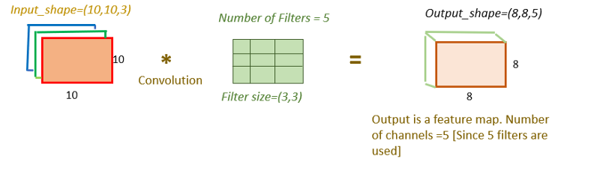
Number of Parameters
Number of filters =3
Filter size =(3,3)
Input shape = (10,10,3)
How to calculate the number of parameters in the convolution layer?
Parameters in one filter of size(3,3)= 3*3 =9
The filter will convolve over all three channels concurrently(input_image depth=3). So parameters in one filter will be 3*3*3=27 [filter size * input_data depth]
Bias =1 [One bias will be added to each filter]
Total parameters for one filter kernel of size (3,3) for depth 3=(3*3*3)+1=28
The total number of filters= 5.
Total parameters for 5 filter kernel of size (3,3) , input_image depth(3)= 28*5=140

Slide 45
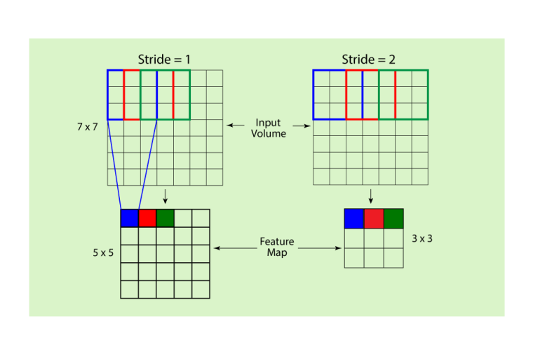
Stride- Example

Slide 46
Strided Convolution

Slide 47
Pooling Layer
Two types
Max Pooling
Average Pooling

Slide 48

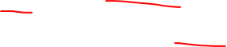
Max Pooling Layer
Need of pooling layer
Similar to the Convolutional Layer, the Pooling layer is responsible for reducing the spatial size of the Convolved Feature Map.
This is to decrease the computational power required to process the data through dimensionality reduction.
Furthermore, it is useful for extracting dominant features which are rotational and positional invariant, thus maintaining the process of effectively training of the model.
The pooling layer is used to reduce the dimensions of the feature maps. Thus, the Pooling layer reduces the number of parameters to learn and reduces computation in the neural network.

Slide 49

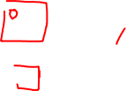
Types of Max Pooling Layer
There are two types of Pooling:
Max Pooling and
Average Pooling.
Max Pooling returns the maximum value from the portion of the image covered by the Kernel.
Average Pooling returns the average of all the values from the portion of the image covered by the Kernel.
Max Pooling also performs as a Noise Suppressant. It discards the noisy activations altogether and also performs de-noising along with dimensionality reduction.
On the other hand, Average Pooling simply performs dimensionality reduction as a noise suppressing mechanism. Hence, we can say that Max Pooling performs a lot better than Average Pooling.

Slide 50
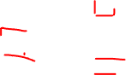
Max Pooling
Take the maximum of the sub region that is considered.
Input 4 × 4 _{Output}
2 | 4 | 7 | 4
6 | 6 | 9 | 8
3 | 4 | 8 | 3
7 | 5 | 3 | 6
Max pooling
→ f = 2 →
s = 2
2 × 2
6 | 9
7 | 8

Slide 51
Average Pooling
Compute the average of the sub region that is considered.
Input 4 × 4 _{Output}
2 | 4 | 7 | 4
6 | 6 | 9 | 8
3 | 4 | 8 | 3
7 | 5 | 3 | 6
Average pooling
f = 2
s = 2
2 × 2
→
→
4.5 | 7
4.75 | 5

Slide 52
Pooling (Pool) Layer
Used for subsampling
Reduce the size of representation
Speed up computation

Slide 53
Pooling
Apply a filter of size f and stride s without padding.
The output dimensions will be
, , ,
,
n − f
n − f
+ 1 × + 1
s s
Fixed computation
Gradient descent is not applied as no learnable parameters
Pooling is applied on each of the channels.

Slide 54
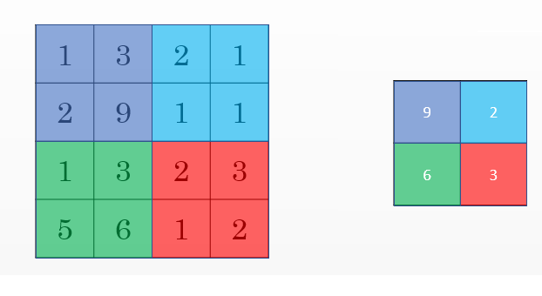
Pooling Layers
Other than the conv layers, CNNs often uses pooling layers to reduce the size of the inputs, speed up computation, and to make some of the features it detects more robust.
Max pooling example:
This example has f = 2, s = 2, and p = 0 hyperparameters

Slide 55
Pooling Layers
The max pooling is saying, if the feature is detected anywhere in this filter then keep a high number. But the main reason why people are using pooling because its works well in practice and reduce computations.
Max pooling has no parameters to learn.
Example of Max pooling on 3D input:
Input: 4x4x10
Max pooling size = 2 and stride = 2
Output: 2x2x10

Slide 56
Pooling Layer
Hyperparameters summary
f : filter size.
s : stride.
Padding are rarely uses here.
Max or average pooling.

Slide 57
Variants of CNN

Slide 58
Architectures for Classification
Dr. Bharathi R
CSE Department

Slide 59
SE ZG568/SS ZG568 , Applied Machine Learning
Lecture No.9.3- Module 9

Slide 60
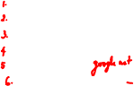
In This Session
LeNet-5
AlexNet
VGG 16
Resnet
Inception
Transfer Learning

Slide 61
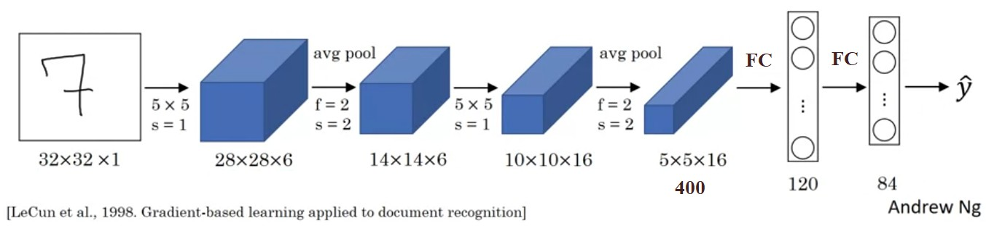
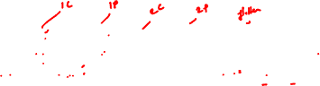
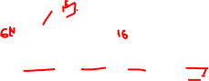
LeNet-5
Handwritten Character recognition 10-categories classification problem
Approx. 60 thousand parameters are learned.

Slide 62
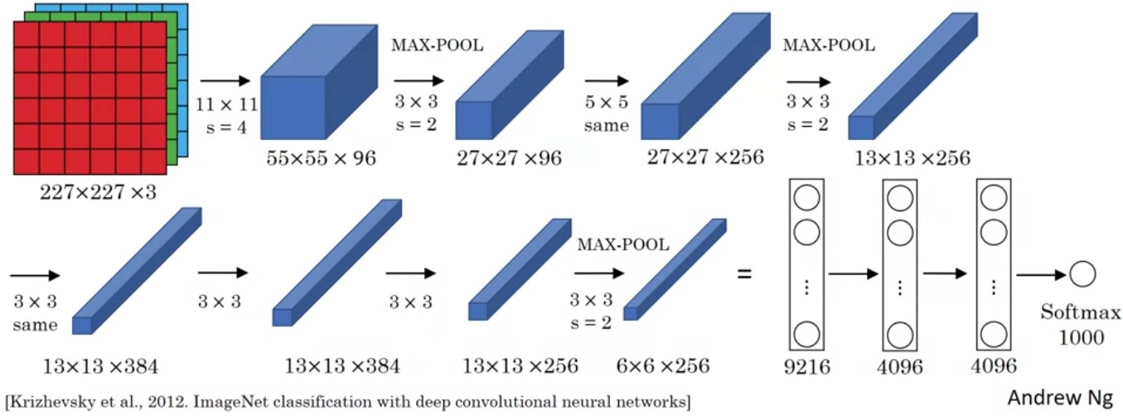
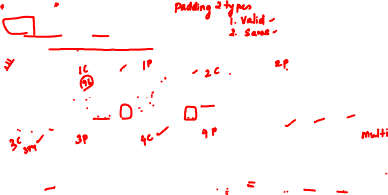
AlexNet
ImagetNet dataset
1000-categories classification problem
Approx. 60 million parameters are learned.

Slide 63
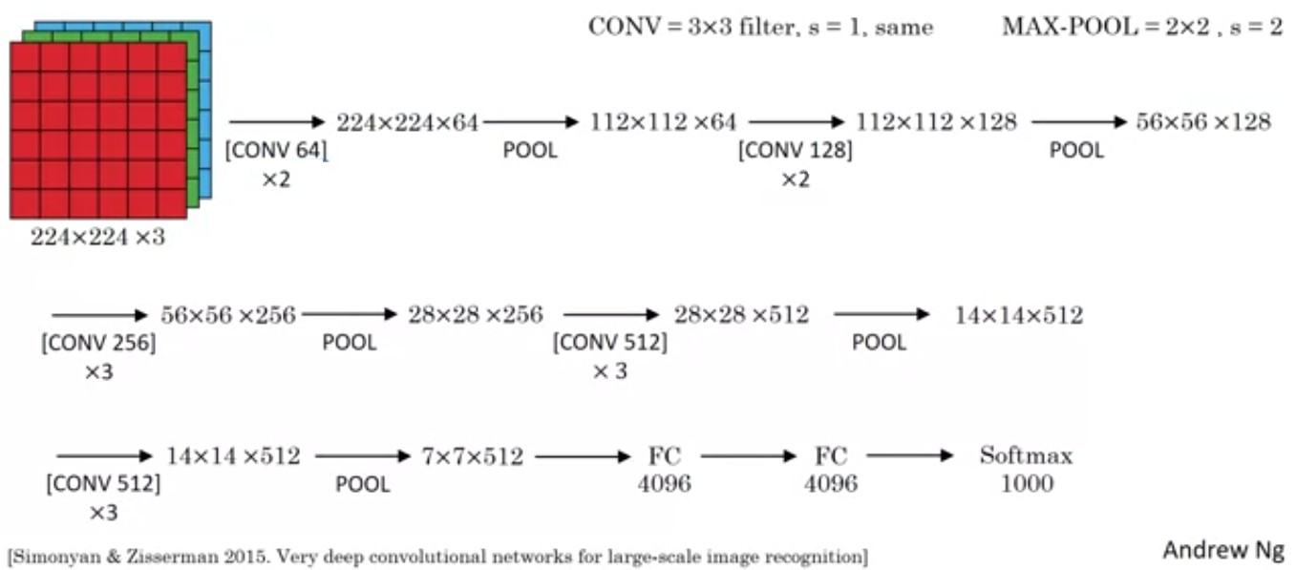
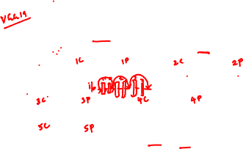
VGG 16
16 Layers
Approx. 138 million parameters are learned.

Slide 64
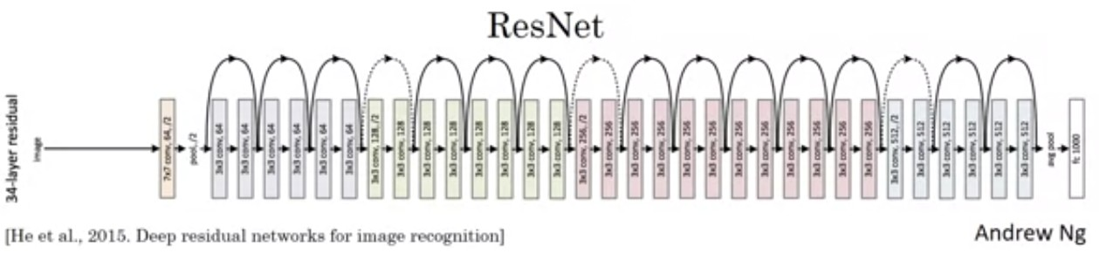
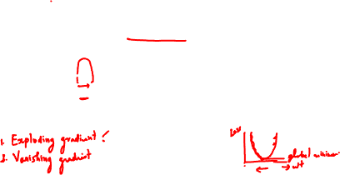
ResNet
Residual block as a shortcut
Reduces the impact of vanishing gradients

Slide 65
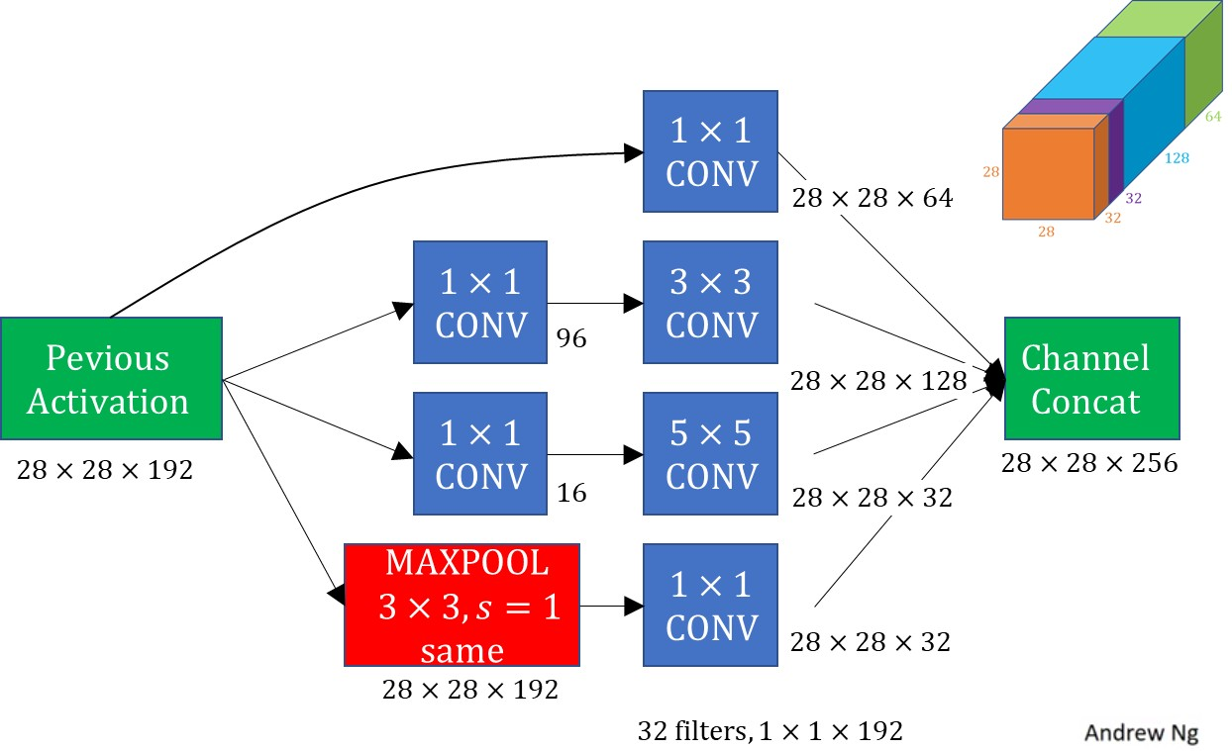
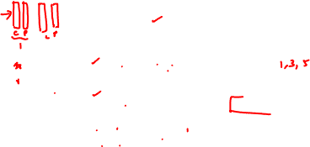
InceptionNet

Slide 66
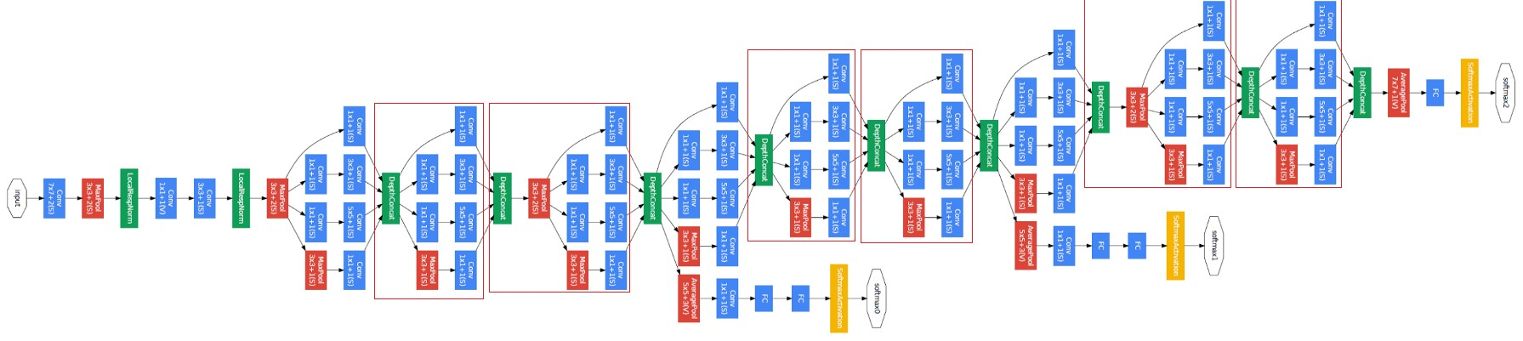
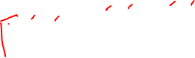
InceptionNet
Szegedy et al. 2014, Going deeper with convolutions.

Slide 67
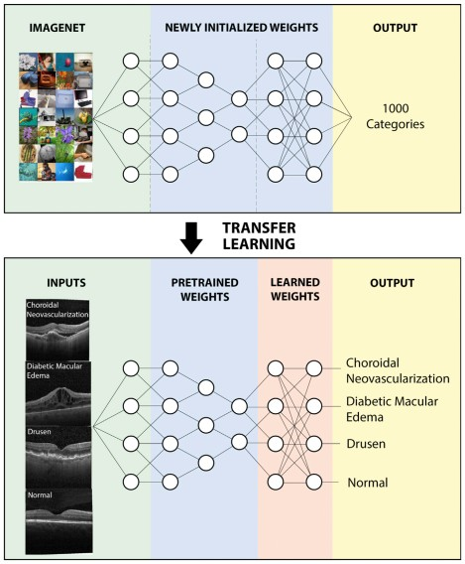
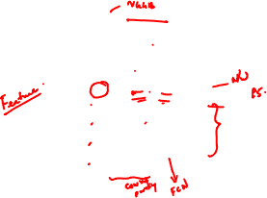
Transfer Learning
Intel Software

Slide 68
Recurrent Neural Network

Slide 69
Recurrent Neural Network
Dr. Bharathi R
CSE Department

Slide 70
SE ZG568/SS ZG568 , Applied Machine Learning
Lecture No.9.4- Module 9

Slide 71
In This Session
Overview
Weights in Hidden Layer
Loss Function

Slide 72
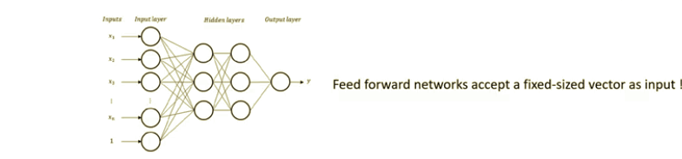
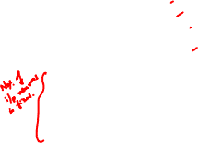
Why Recurrent Neural Networks
For example, Sentiment Analysis,
Let us try to classify the following text as positive or negative:
1. I like this phone – Positive
2. This phone is good – Positive
3. This phone is not okay – Negative
4. I do not like this phone because battery is not charging properly- Negative

Slide 73
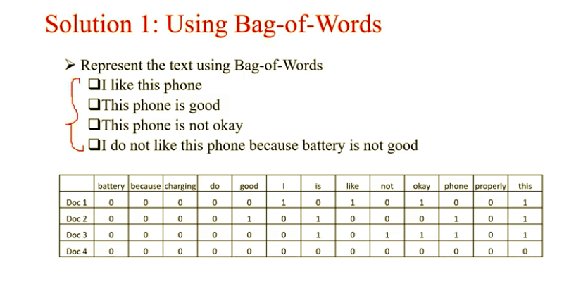
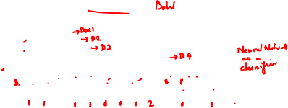
Why Recurrent Neural Networks

Slide 74
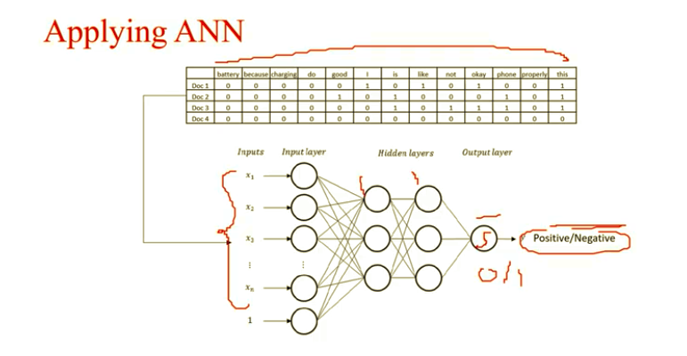
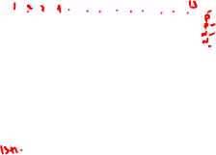
Why Recurrent Neural Networks

Slide 75
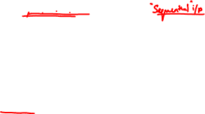
Why Recurrent Neural Networks
Drawback of BoW
For example, let us try to represent the following text using Bag-of- Words
This phone is no good – Negative
No this phone is good – Positive
 | good | is | no | phone | this
Document1 | 1 | 1 | 1 | 1 | 1
Document 2 | 1 | 1 | 1 | 1 | 1
Feed Forward Neural Networks with Bag-of-Words(BoW) model does not
Consider position of words in input

Slide 76


Why Recurrent Neural Networks
Example : 2, Word Guessing Game

Slide 77
Why Recurrent Neural Networks
Other situations where sequence matters
Stock price data will be more or less similar to yesterday’s price
Tomorrow’s temperature will be close to today’s temperature

Slide 78












Examples of sequence data
“The quick brown fox jumped over the lazy dog.”
Speech recognition
Music generation
∅
“There is nothing to like in this movie.”
Sentiment classification
DNA sequence analysis
AGCCCCTGTGAGGAACTAG
AGCCCCTGTGAGGAACTAG
Machine translation
Voulez-vous chanter avec moi?
Do you want to sing with me?
Video activity recognition
Running
Name entity recognition
Yesterday, Harry Potter met Hermione Granger.
Yesterday, Harry Potter met Hermione Granger.
Andrew Ng

Slide 79


Why Recurrent Neural Networks
Drawbacks of Standard Neural Network
Feed forward networks accept a fixed-sized vector as input and produce fixed-sized vector as output
So, feed forward networks cannot process sequential data containing variable length of data
Feed forward networks does not consider sequence in the data.

Slide 80

Why Recurrent Neural Networks
Solution for Sequence Analysis
Recurrent Neural Network allows us to operate over sequence of vectors.
Recurrent, because previous output is also used with current input.
RNN also viewed as having a “memory”.
Unlike a traditional neural network, RNN shares same parameters across all steps.
Greatly reduce the total number of parameters we need to learn.
RNN is not feedforward network, as cycle is formed in hidden units.

Slide 81


Why Recurrent Neural Networks
NN Vs RNN

Slide 82


Recurrent Neural Networks

Slide 83


Recurrent Neural Networks

Slide 84


Recurrent Neural Networks

Slide 85


Recurrent Neural Networks

Slide 86



RNN Forward Pass

Slide 87



RNN Example-1
PRP: personal pronoun, vbp:Verb, present tense, other than third person singular, nns:noun,plural

Slide 88



RNN Example-2

Slide 89


RNN- Variants
Input vectors are in red, output vectors are in blue and green vectors hold the RNN's state

Slide 90

RNN- Variant-1
(1) Vanilla mode of processing without RNN, from fixed-sized input to fixed-sized output (e.g. image classification).

Slide 91


RNN- Variant-2
(2) Sequence output (e.g. image captioning takes an image and outputs a sentence of words).

Slide 92


RNN- Variant-3
(3) Sequence input (e.g. sentiment analysis where a given sentence is classified as expressing positive or negative sentiment).

Slide 93


RNN- Variant-4
(4) Sequence input and sequence output (e.g. Machine Translation: an RNN reads a sentence in English and then outputs a sentence in French)

Slide 94


RNN- Variant-5
(5) Synced sequence input and output (e.g. video classification where we wish to label each frame of the video).

Slide 95



RNN Example-3
Language Modelling

Slide 96


RNN Example-4

Slide 97



Disadvantages of RNN

Slide 98


How to train RNNs?

Slide 99

How to train RNNs?

Slide 100
LSTM

Slide 101
Long Short Term Memory
Dr. Bharathi R
CSE Department

Slide 102
SE ZG568/SS ZG568 , Applied Machine Learning
Lecture No.9.5- Module 9

Slide 103

In This Session
Traning RNN
Backpropagation Through Time
Issues with BPTT
Long Short term Memory
RNN Variants

Slide 104


Backpropagation Through Time
_{y}<t>
^{W}h⁼[^{W}hh ^{; W}hx ]
_{y}<t-1>
^{W}yh
_{h}<t-1>
_{y}<t>
^{W}yh
_{h}<t>
_{y}<t+1>
^{W}yh
_{h}<t+1>
^{W}yh
W
hh
W
W
_{h}<t>
Unfold
hh
hh
^{W}hx
^{W}hx
_{x}<t-1>
^{W}hx
_{x}<t>
^{W}hx
_{x}<t+1>
_{x}<t>

Slide 105

Issues with BPTT
Gradient Clipping: set a max value for gradients if they grow to large (solves only exploding gradient problem)
Truncated backpropagation through time (TBPTT)
simply limits the number of time steps the signal can backpropagate each forward pass.
e.g., even if the sequence has 100 elements/steps, we may only backpropagate through 20 or soe
Long short-term memory (LSTM) -- uses a memory cell for modeling long-range dependencies and avoid vanishing gradient problems

Slide 106


Long Short-term Memory Cell

Slide 107


Long Short-term Memory Network

Slide 108


Cell State

Slide 109

Hidden State

Slide 110

Gates

Slide 111


Gates

Slide 112


Gates

Slide 113


Cell State Calculation

Slide 114



Output Gates

Slide 115


Gated recurrent Unit (GRU)

Slide 116


Bidirectional RNN

Slide 117
Applications

Slide 118
Neural Networks II
Applications
Dr. Bharathi R
CSE Department

Slide 119
SE ZG568/SS ZG568 , Applied Machine Learning
Lecture No.9.6- Module 9

Slide 120
In This Session
Sequence Modeling
Generating Names
Language Translation
Data processing for “character” RNN

Slide 121

Types of Sequence Modeling
many-to-one
one-to-many
many-to-many
many-to-many
Figure based on:
The Unreasonable Eﬀectiveness of Recurrent Neural Networks by Andrej Karpathy (http://karpathy.github.io/2015/05/21/rnn-eﬀectiveness/)

Slide 122
Many-to-One Modeling
Many-to-one: The input data is a sequence, but the output is a fixed-size vector, not a sequence.
many-to-one
one-to-many
Ex.: sentiment analysis, the input is some text, and the output is a class label.
many-to-many
many-to-many
Figure based on:
The Unreasonable Eﬀectiveness of Recurrent Neural Networks by Andrej Karpathy (http://karpathy.github.io/2015/05/21/rnn-eﬀectiveness/)

Slide 123
One-to-Many Modeling
One-to-many: Input data is in a standard format (not a sequence), the output is a sequence.
Ex.: Image captioning, where the input is an image, the output is a text description of that image
many-to-one
one-to-many
many-to-many
many-to-many
Figure based on:
The Unreasonable Eﬀectiveness of Recurrent Neural Networks by Andrej Karpathy (http://karpathy.github.io/2015/05/21/rnn-eﬀectiveness/)

Slide 124
Many-to-Many Modeling
Many-to-many: Both inputs and outputs are sequences. Can be direct or delayed.
Ex.: Video-captioning, i.e., describing a sequence of images via text (direct).
Translating one language into another (delayed)
many-to-one one-to-many
many-to-many
many-to-many
Figure based on:
The Unreasonable Eﬀectiveness of Recurrent Neural Networks by Andrej Karpathy (http://karpathy.github.io/2015/05/21/rnn-eﬀectiveness/)

Slide 125
Example: One-to-Many
many-to-one
one-to-many
many-to-many
Figure based on:
many-to-many
The Unreasonable Eﬀectiveness of Recurrent Neural Networks by Andrej Karpathy (http://karpathy.github.io/2015/05/21/rnn-eﬀectiveness/)

Slide 126













Generating Names
many-to-many
"training"
many-to-many
"one"
"generating new text"
Generating Names with a Character-level RNN
https://pytorch.org/tutorials/intermediate/char_rnn_generation_tutorial.html

Slide 127









Generating Names
At each time step Softmax output (probability) for each possible"next letter"
For next each input, ignore the prediction but use the
"correct" next letter from the dataset
many-to-many
"training"

Slide 128





Generating Names
To generate new text, now, sample from the softmax outputs and provide the letter as input to the next time step
many-to-many
"one"
Note that this approach works with both Word- and Character-RNNs
"generating new text"

Slide 129

Language Translation
many-to-many
Translation with a Sequence to Sequence Network and Attention (English to French)
https://pytorch.org/tutorials/intermediate/seq2seq_translation_tutorial.html

Slide 130


Data Processing for a Character RNN
Step 1: Break up text into characters
Data:
“Hello world!”
Break it into a sequence of
characters
Input Sequence:
‘H’ ‘e’ ‘l’ ‘l’
‘o’
‘ ‘
‘w’ ‘o’ ‘r’ ‘l’ ‘d’
‘!‘
EOS
Predicting next character:
Output Sequence
‘e’ ‘l’ ‘l’ ‘o’ ‘ ‘ ‘w’ ‘o’ ‘r’ ‘l’ ‘d’ ‘!‘
EOS

Slide 131


Data Processing for a Character RNN
Step 2: Define Mapping Dictionaries
Mapping characters to integers
Mapping integers to characters
char2int
int2char

Slide 132
Data Processing for a Character RNN
Step 3: Define Inputs and Outputs
Text Corpus
Convert text into a long sequence of integers
Outputs are the characters shifted by 1 position as we want to predict the next character
49, 29, 29, 29, 5, 19, 27, 0, 7, 3, 36, 65, 27,
41, 31, 0, 26, 4, 31, 27, 86, 10, 27, 3, 84, 67,
12, 0, 80, 31, 27, 58, 31, 0, 36, 28, 0, 75, 19,
22, . . . , 52, 84, 19, 31, 0, 22
Create sequences x and y
Sequence x:
49, 29, 29, 29, 5, 19, 27, 0, 7, 3, 36, 65, 27,
41, 31, 0, 26, 4, 31, 27, 86, 10, 27, 3, 84, 67,
12, 0, 80, 31, 27, 58, 31, 0, 36, 28, 0, 75, 19,
22, . . . , 52, 84, 19, 31, 0, 22
Sequence y:
49, 29, 29, 29, 5, 19, 27, 0, 7, 3, 36, 65, 27,
41, 31, 0, 26, 4, 31, 27, 86, 10, 27, 3, 84, 67,
12, 0, 80, 31, 27, 58, 31, 0, 36, 28, 0, 75, 19,
22, . . . , 52, 84, 19, 31, 0, 22
Letters/words can be represented by one-hot encoding
For words, semantic encodings available, e.g., word2vec, GLOVE etc.

Slide 133
FAccT Machine Learning

